Slide 1

INT-353 EDA Project McDonalds Menu Data Analysis
Teacher Name: Ms. Shivangini Gupta
Name : Garvit Joshi
Section : K21UT
Group : 1
Registration Number : 12106692
Roll No : 21

Slide 2
Agenda
Problem Statement
Data Collection
Performing EDA
Recommendation
Future Scope
Presentation Title

Slide 3

Problem Statement
Collected data from Kaggle and imported it into jupyter notebook and converted into a data frame to further processing and draw insights from the data.
https://www.kaggle.com/datasets/deepcontractor/mcdonalds-india-menu-nutrition-facts

Slide 4
Approaches
1. Data Import
2. Data Cleaning
3. Data Pre-processing
4. Analysis
5. Plot Graphs
6. Draw Insights

Slide 5
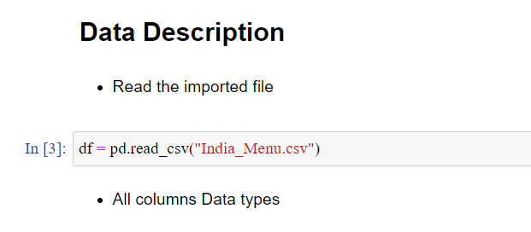
Data Collection

Slide 6
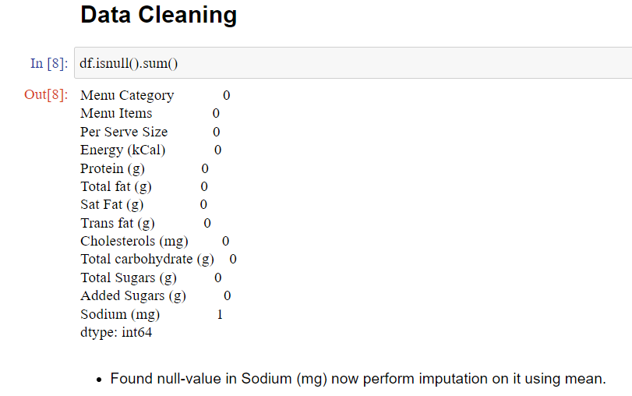
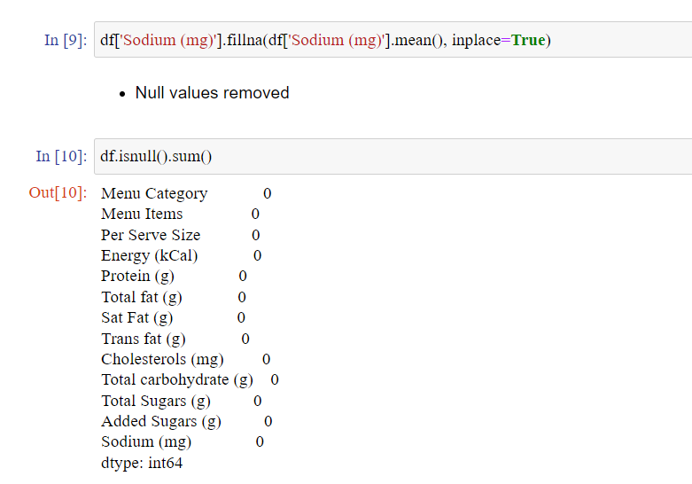
Performing EDA 1. Data Cleaning and Preprocessing

Slide 7
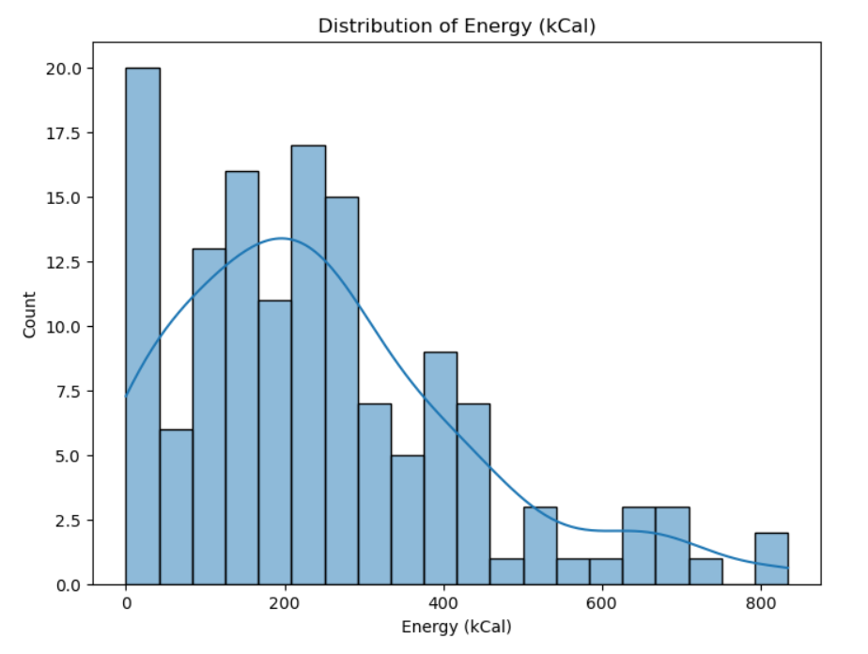
2. Univariate Analysis

Slide 8
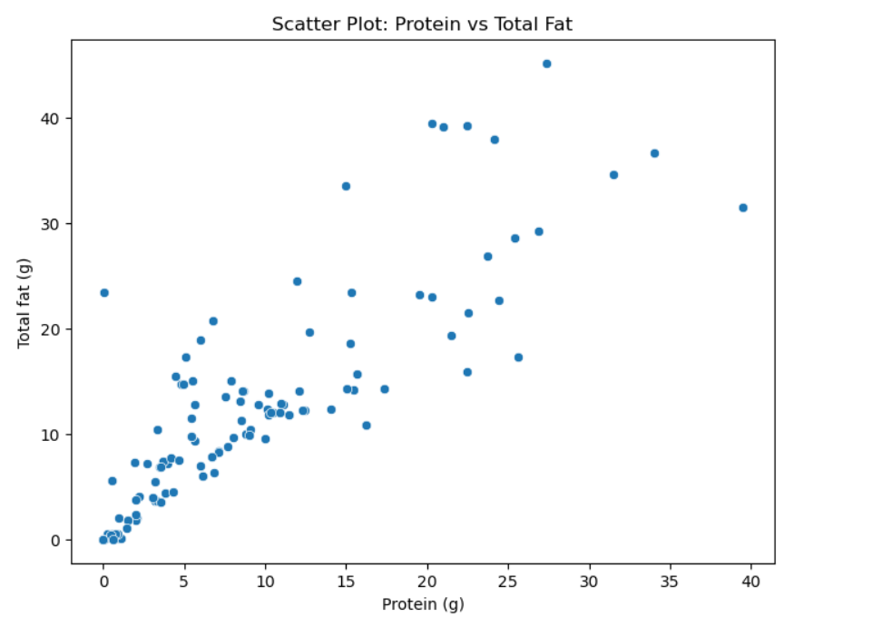
2. Bivariate Analysis

Slide 9
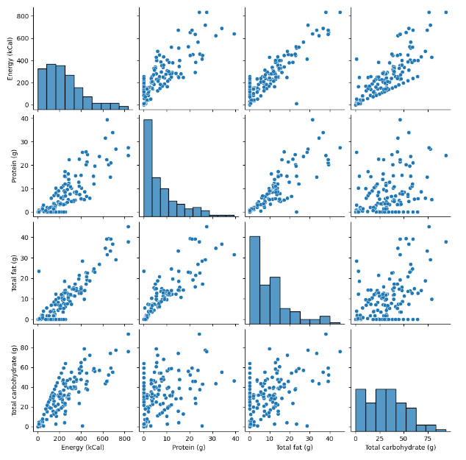
3. Multivariate Analysis

Slide 10
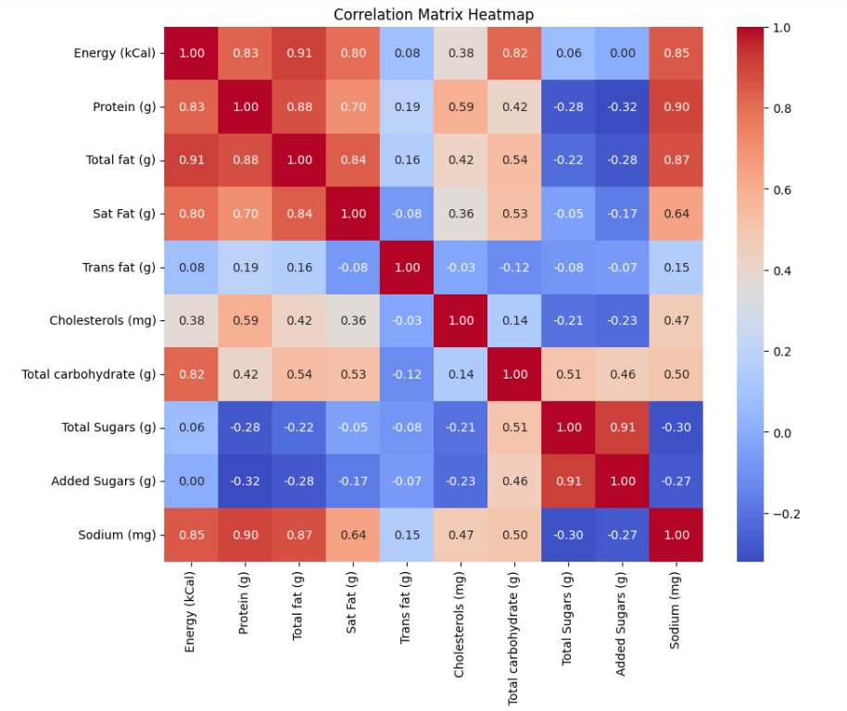
4. Correlation Heatmap
The correlation heatmap shows the correlation between the different nutrients in the McDonald's menu items. The darker the color in a cell, the stronger the correlation between the two nutrients.

Slide 11
Key Insights
1. McDonald's menu items tend to be high in energy, total fat, cholesterol, and protein. More than half of the menu items have more than 390 kcal of energy, 30 grams of total fat, 75 milligrams of cholesterol, and 25 grams of protein.
2. There is a strong positive correlation between protein and total fat in McDonald's menu items. This means that as the protein content of a menu item increases, the total fat content also tends to increase.
3. Consumers who are trying to lose weight or manage their blood sugar levels should be mindful of the protein and total fat content of the McDonald's menu items they choose. High-protein, high-fat items, such as the Big Mac and Quarter Pounder with Cheese, should be avoided or consumed in moderation.

Slide 12



Recommendation
Offer more lower-energy, lower-fat, and lower-cholesterol menu items. This could include more salads, grilled chicken sandwiches, and fish sandwiches.
Reduce the portion sizes of high-energy, high-fat, and high-cholesterol menu items. This could be done by offering smaller burgers and fries, or by offering half-sized portions.
Make healthier ingredients, such as lean protein, whole grains, and fresh fruits and vegetables, more visible and accessible on the menu. This could be done by placing these items at the top of the menu or by offering them as side items instead of fries.
Educate customers about the nutritional content of McDonald's menu items. This could be done through signage in the restaurants, on the website, and on social media.

Slide 13
Future Scope
Incorporate data from other fast-food restaurants to make comparisons. This would allow McDonald's to see how their menu items compare to those of their competitors.
Use machine learning to predict the nutritional content of new menu items. This would allow McDonald's to develop healthier menu items without having to go through the time and expense of laboratory testing.
Use natural language processing to analyze customer feedback about the nutritional content of McDonald's menu items. This would allow McDonald's to identify areas where they can improve their menu.
Use data visualization to create interactive tools that help customers make healthier choices. For example, McDonald's could create a tool that allows customers to compare the nutritional content of different menu items or to create their own custom meals.

Slide 14




Thank you

